Slide 1


SAP UI5 & FIORI with OData TRAINING
Anubhav Oberoy & Nishan Nainsukha
Day – 14

Slide 2

Agenda – Day 14
EPM Data Model
Creating OData Service
TCode & ABAP SEGW CLASSES
Building GetEntitySet Method
Building GetEntity(Single Record) Method
Postman Tool

Slide 3
EPM Data Model
Enterprise Procurement Model – Products, Business Partner (Suppliers and Customers), Orders and Order Items.
BAPIs = Function Modules which are reusable and can be called from another systems as well
BAPI_EPM*
BAPI_EPM_PRODUCT_GET_LIST – All the list of products in the system
BAPI_EPM_PRODUCT_GET_DETAIL – details of a single product
BAPI_EPM_PRODUCT_CREATE – create a new product
BAPI_EPM_PRODUCT_UPDATE – update existing product
BAPI_EPM_PRODUCT_DELETE – delete the product
Business partners (BP)
BAPI_EPM_BP_GET_LIST
BAPI_EPM_BP_GET_DETAIL
BAPI_EPM_BP_CREATE
BAPI_EPM_BP_UPDATE
BAPI_EPM_BP_DELETE
CRUD
Create
Read
Update
Delete

Slide 5
MPC = Model Provider Class (metadata) = where all the abap code will be generated which will have the code for metadata, if I want to customize this code can I do it in MPC class?
DPC = Data Provider Class (data operations CRUDQ) = Contains all the implementation of CURDQ. It will get for each entityset 5 methods.
<entity>_GET_ENTITYSET ➔ ALL THE DATA
<entity>_GET_ENTITY ➔ Single Record by KEY
<entity>_CREATE_ENTITYSET ➔ Create
<entity>_UPDATE_ENTITYSET ➔ Update
<entity>_DELETE_ENTITYSET ➔ Remove Data

Slide 7
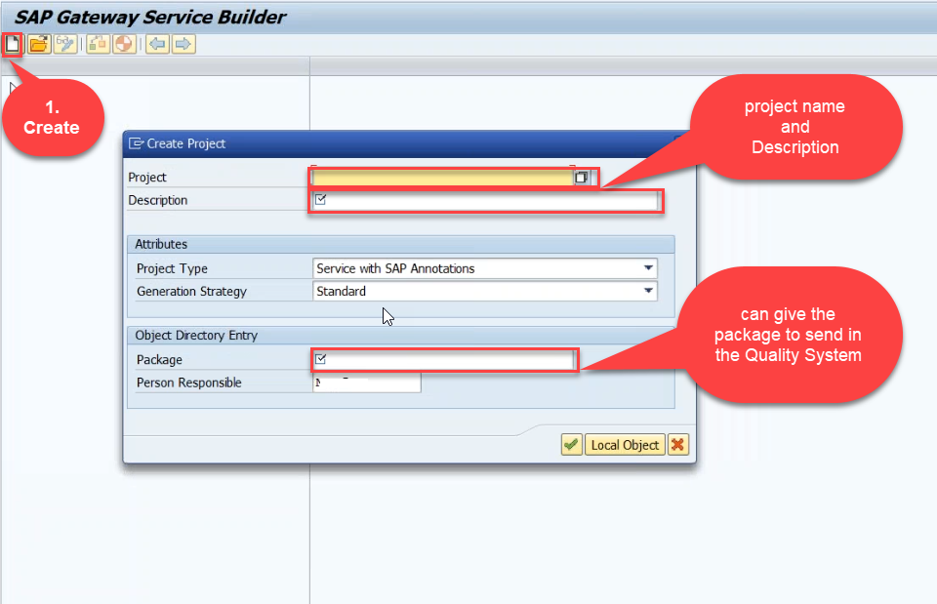
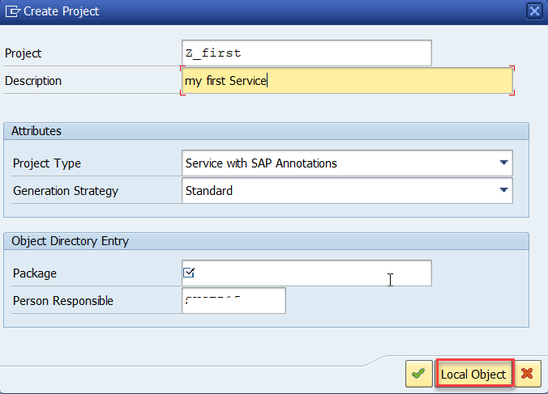
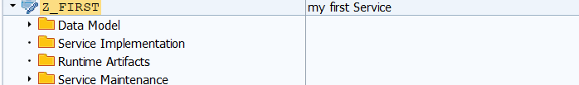
Creating OData Service
Step1: Strat your SAP LOGON, and to Sap Gateway Service Builder(SEGW) and click on Create

Slide 8
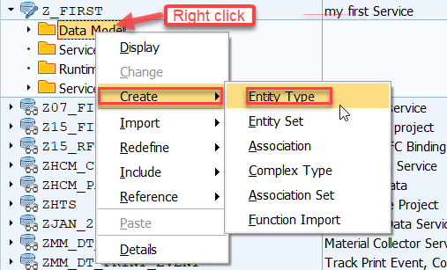
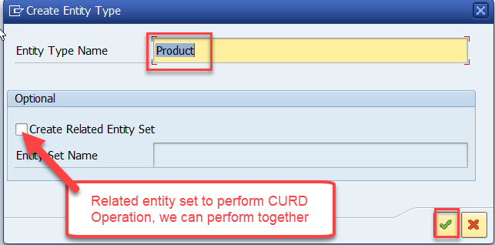
Creating OData Service
Step2: Defining the Data Model (Blue print of data)

Slide 9
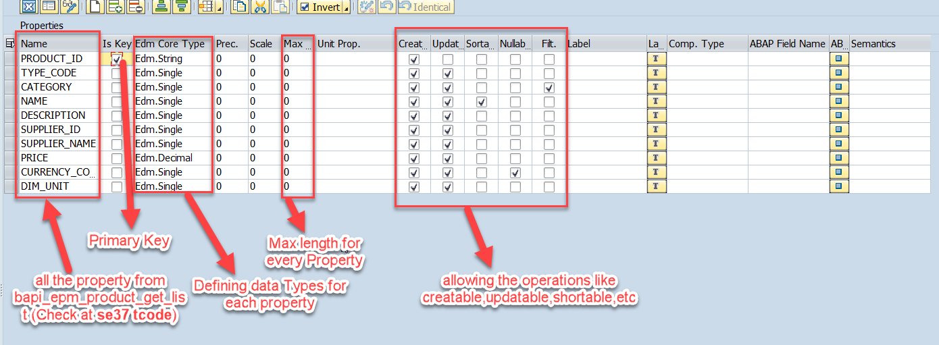
Creating OData Service
Step3: Creating Properties for data model (from bapi_epm_product_get_list (tcode- se37))

Slide 10
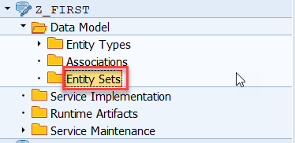
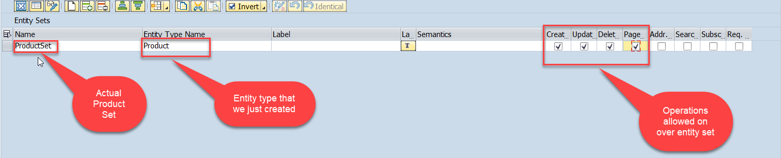
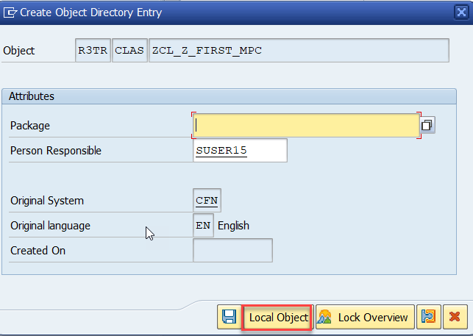
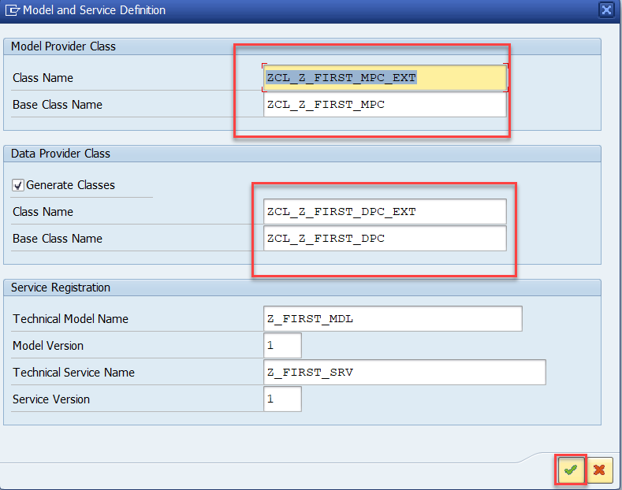
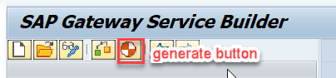
Creating OData Service
Step4: Creating entity set to perform actual CURD operations and service generation

Slide 11
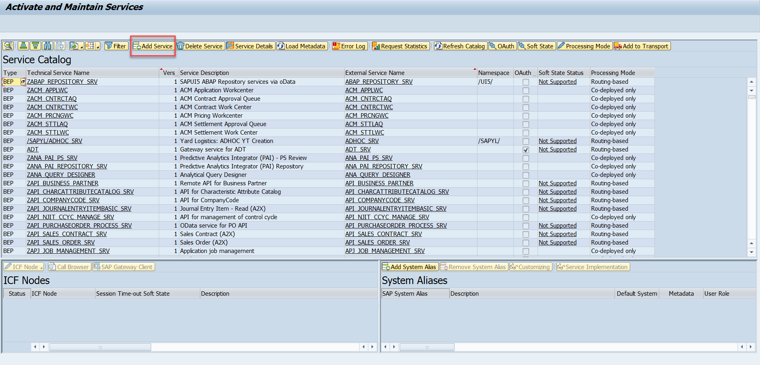
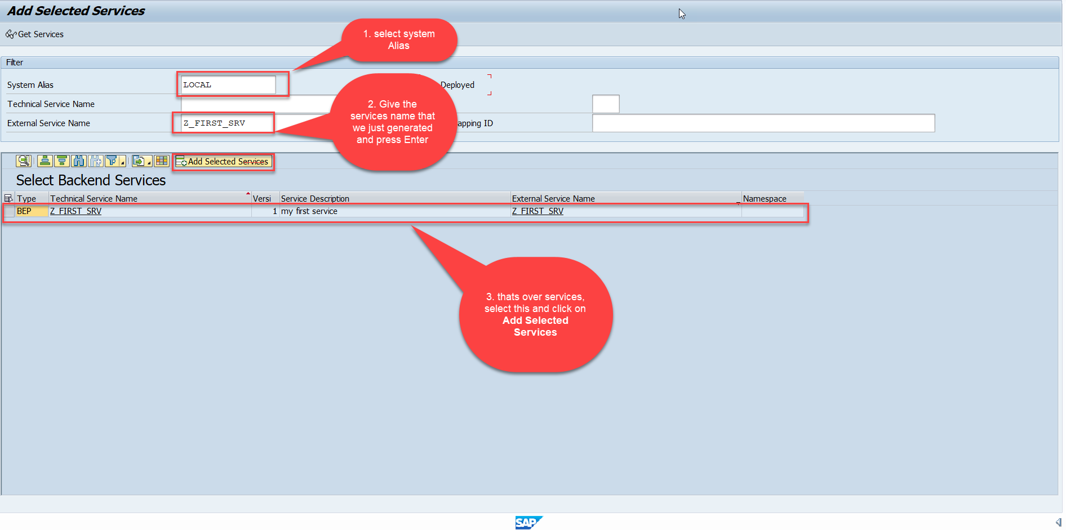
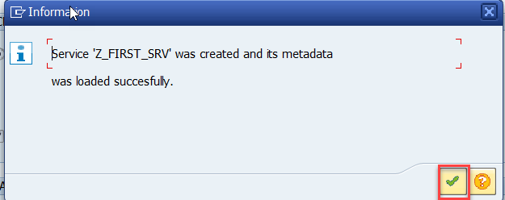
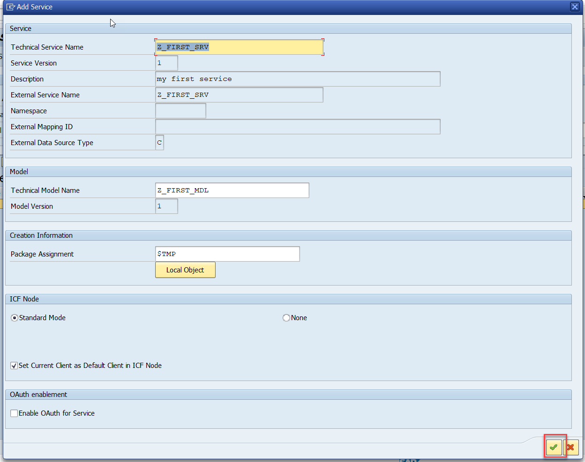
Creating OData Service
Step5: Service Registration (Go to tcode- /iwfnd/maint_service)

Slide 12
TCode
SEGW – Service Builder
/N/IWFND/MAINT_SERVICE – Registration of services
/N/IWFND/ERROR_LOG – Error logs of service calls
/N/IWFND/GW_CLIENT – test services locally within sap system
ABAP SEGW CLASSES
It has the code which provides the metadata
SAP Generated
It has the code which provides the actual data in the output when EntitySet is called
Runtime Artifacts
MPC
(Model provider Class)
DPC
(Data Provider Class)
MPC_EXT (Extension)
Code which developer will write
DPC_EXT (Extension)
All the ABAP Code which works with CRUD implementations

Slide 13
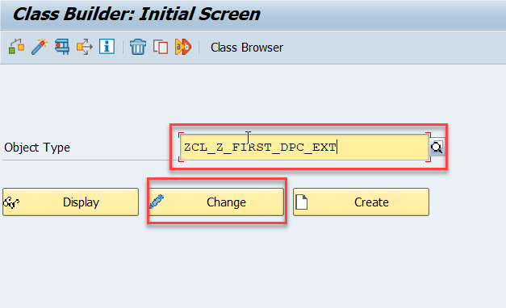
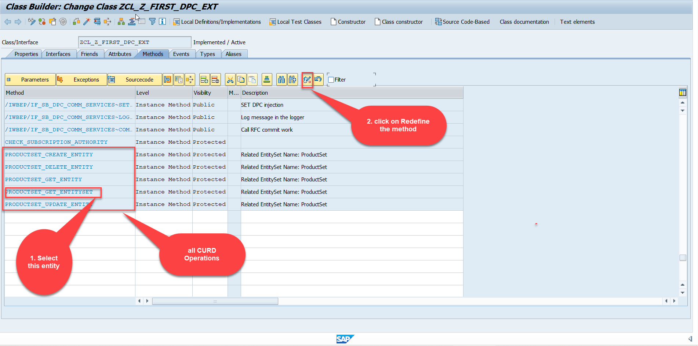
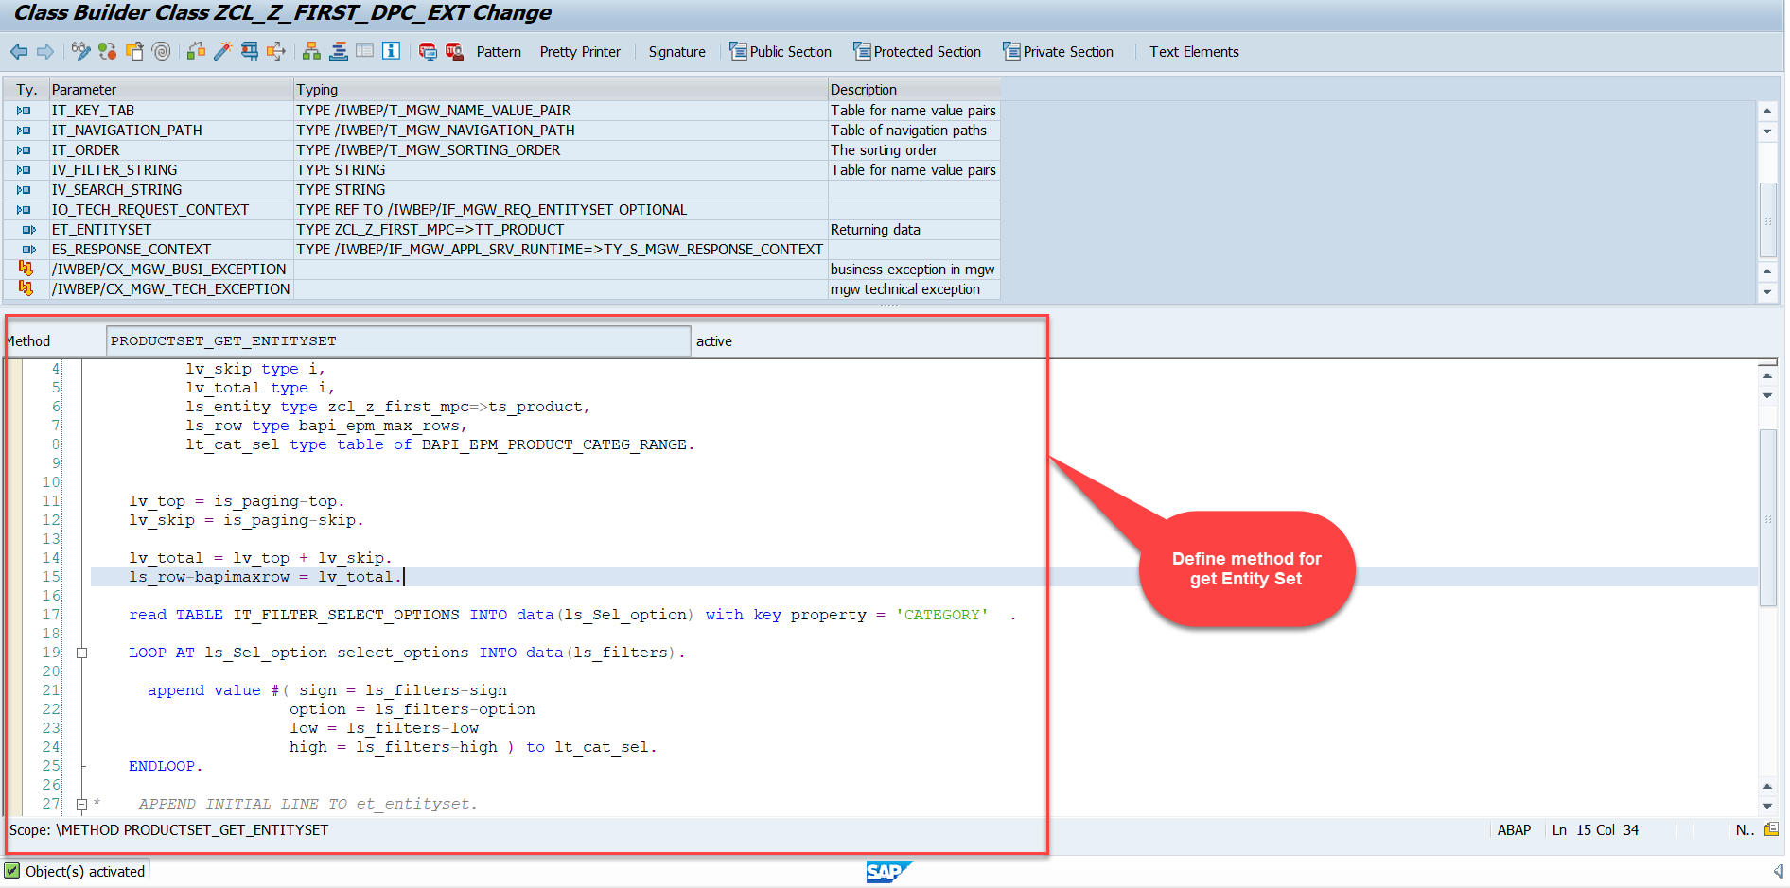
Building GetEntitySet Method
Step1: ProductSet Get Entity method(with filter, top and skip) in DPC Extension (Class Builder tcode- se24)
Note: Click on the image to get Complete code.

Slide 14
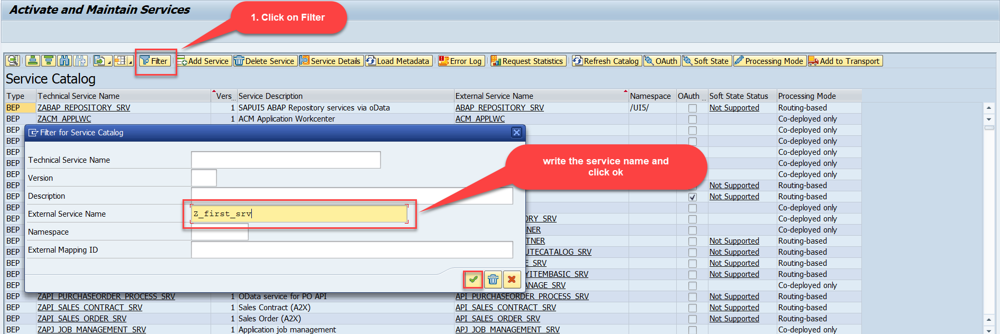
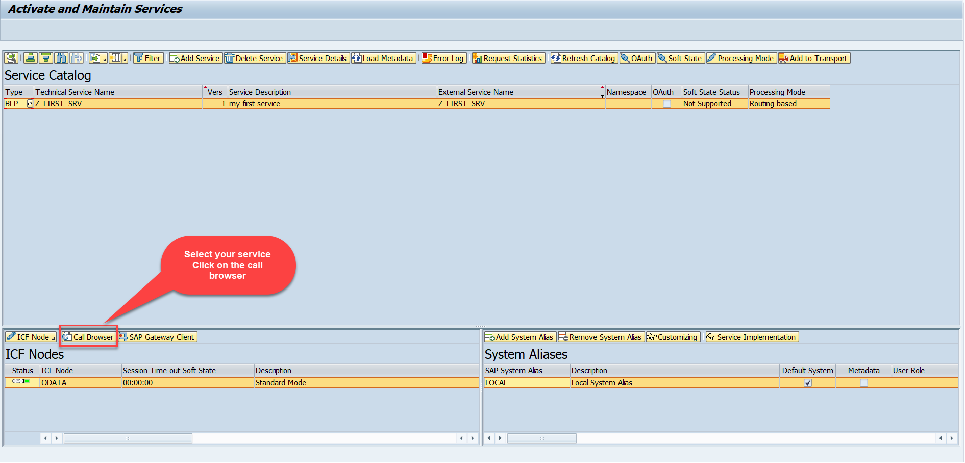
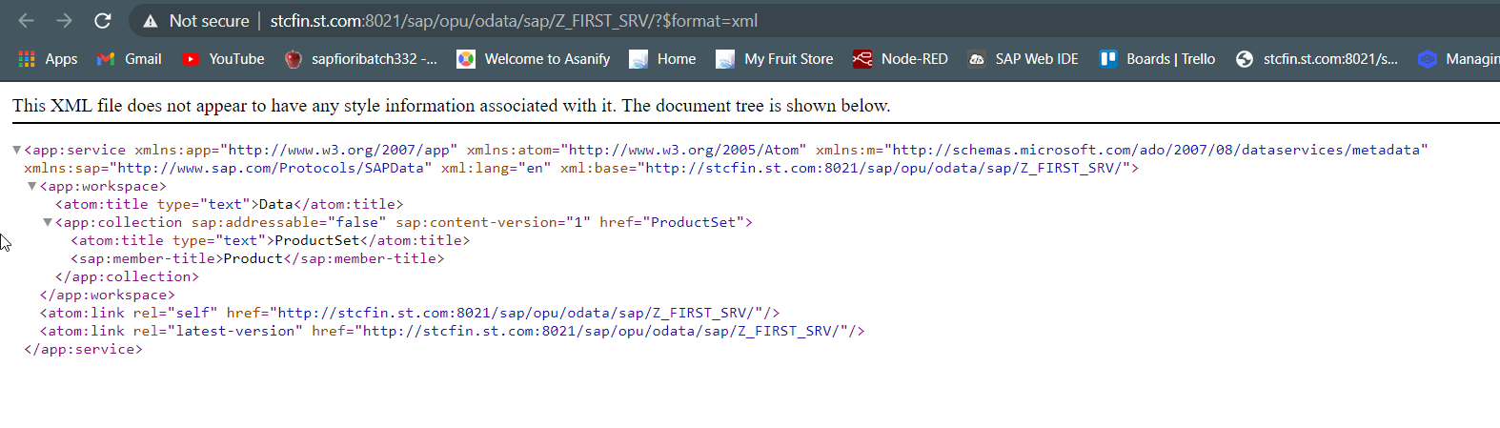
Building GetEntitySet Method
Step2: Call the service to the browser that we just created (go to service maintain (/iwfnd/maint_service))
Service in Browser

Slide 15
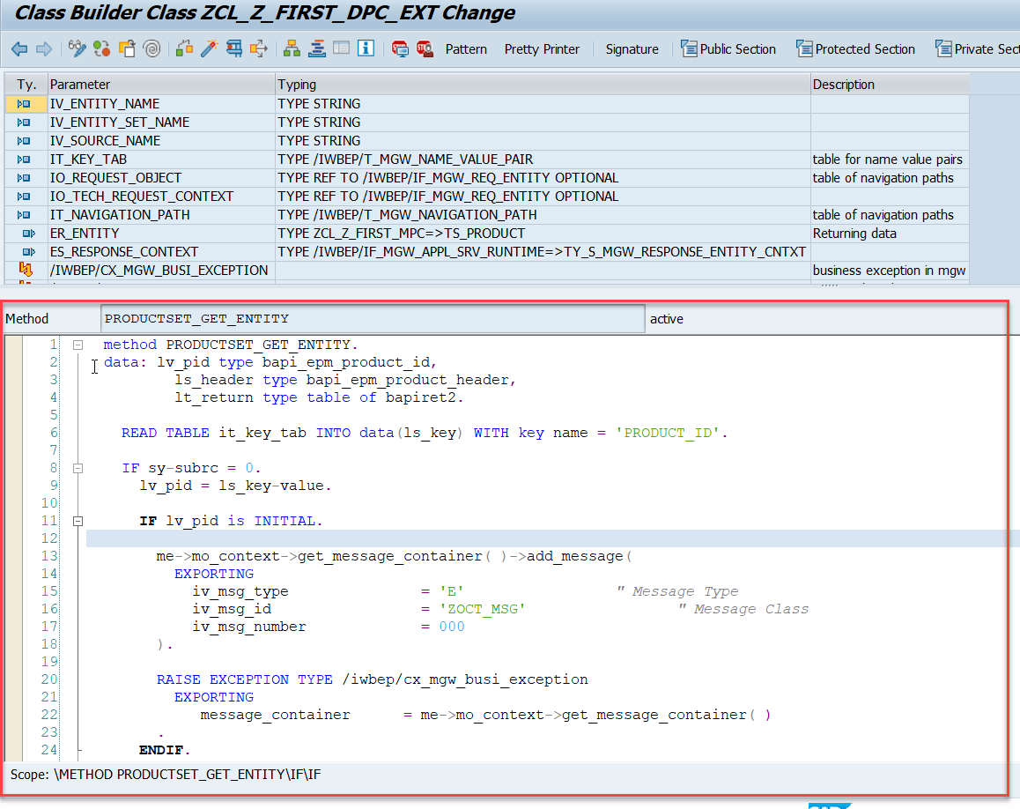
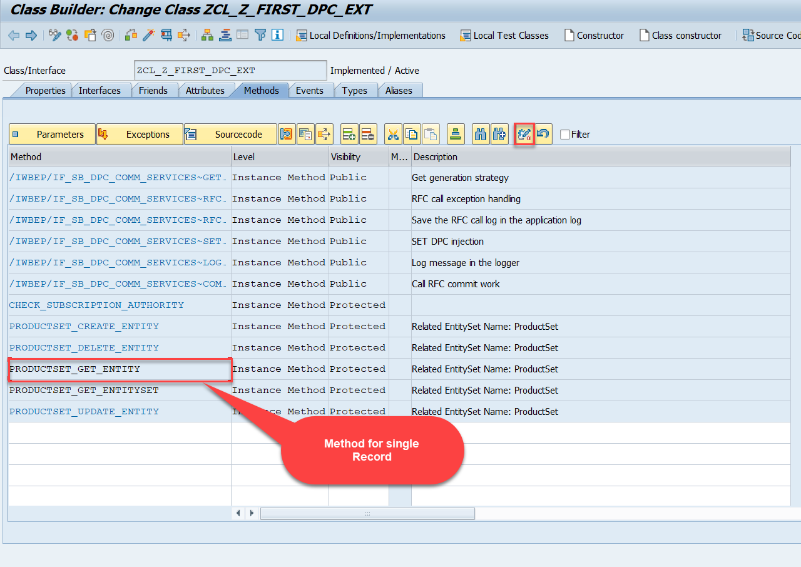
Building GetEntity(Single Record) Method
Go to DPC Extension of over service and redefine the method PRODUCTSET_GET_ENTITY

Slide 16
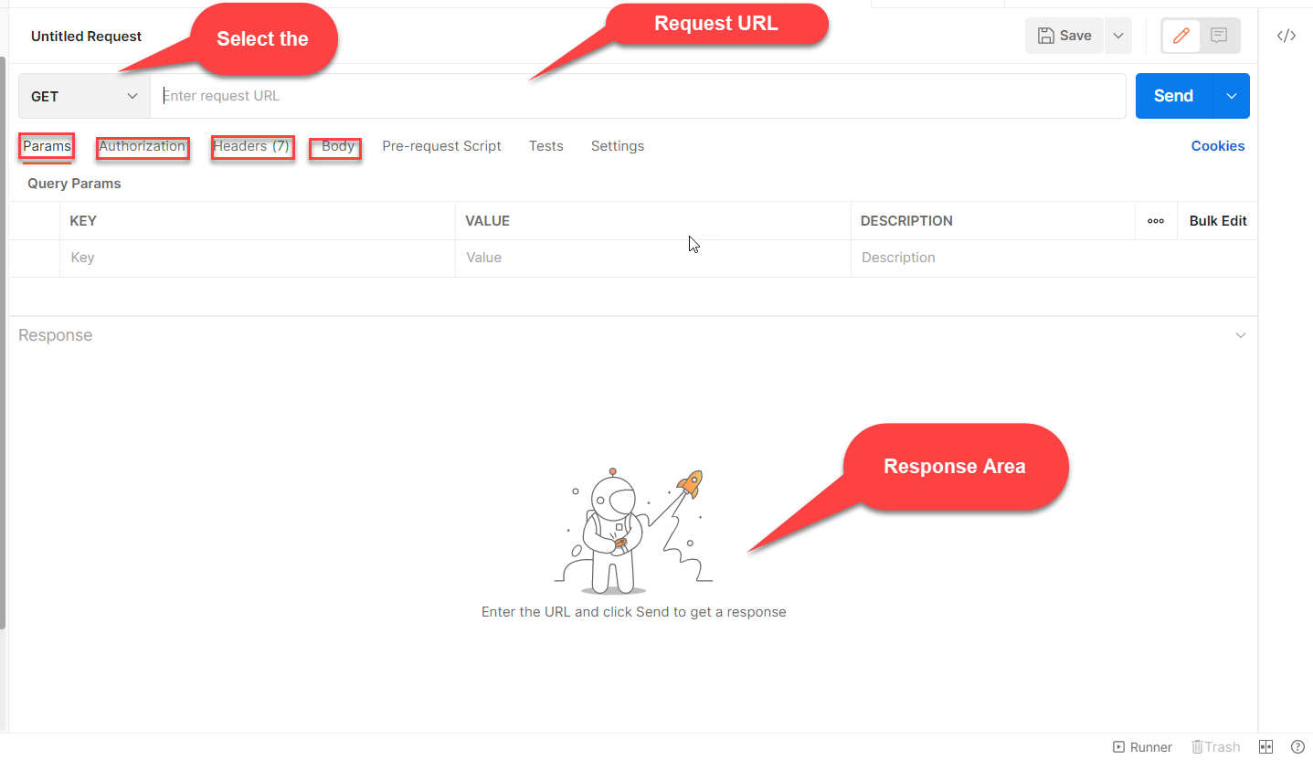

Postman
Postman is an API platform for building and using APIs. Postman simplifies each step of the API lifecycle and streamlines collaboration so you can create better APIs—faster.

Slide 17

End of Day 14

Slide 18

Questions

Slide 19

Anubhav Oberoy

Slide 20


We’re committed to empower you to be
Most Desirable Resource
through powerful training solutions.
We build the workforce of the future.
250+
Corporate Clients
30,000+
Learners Trained
25000+
Learners Placed
FREE WEBINARS
Sign up for free webinars with industry experts every fortnight!
Enroll Now!
Contact us today!
https://anubhavtrainings.com/

Slide 21




More from AnubhavTrainings.com

